Slide 1
Service-Now Training
Service-Now Training
Introduction
Update Set
Data
Development
Scripting and APIs
Debugging
Integration

Slide 2
Service-Now Training
Update Set
After completing this module, you will be able to understand -
What is an Update Set
How to create an Update Set
How to use an Update Set
Best Practices

Slide 3
Service-Now Training
Update Set → Description
An Update Set is a collection of changes (customizations) by developers in Service-Now that can be moved from one environment to another.
Set of enhancements to particular applications and can be grouped into an update set.
In web applications, generally the deployment is done by exporting the application to an archive file (Example: .war, .ear etc…) and deploying this archived file to the server. In Service-Now, the application changes are captured in an update set and this update set is moved to another environment.

Slide 4
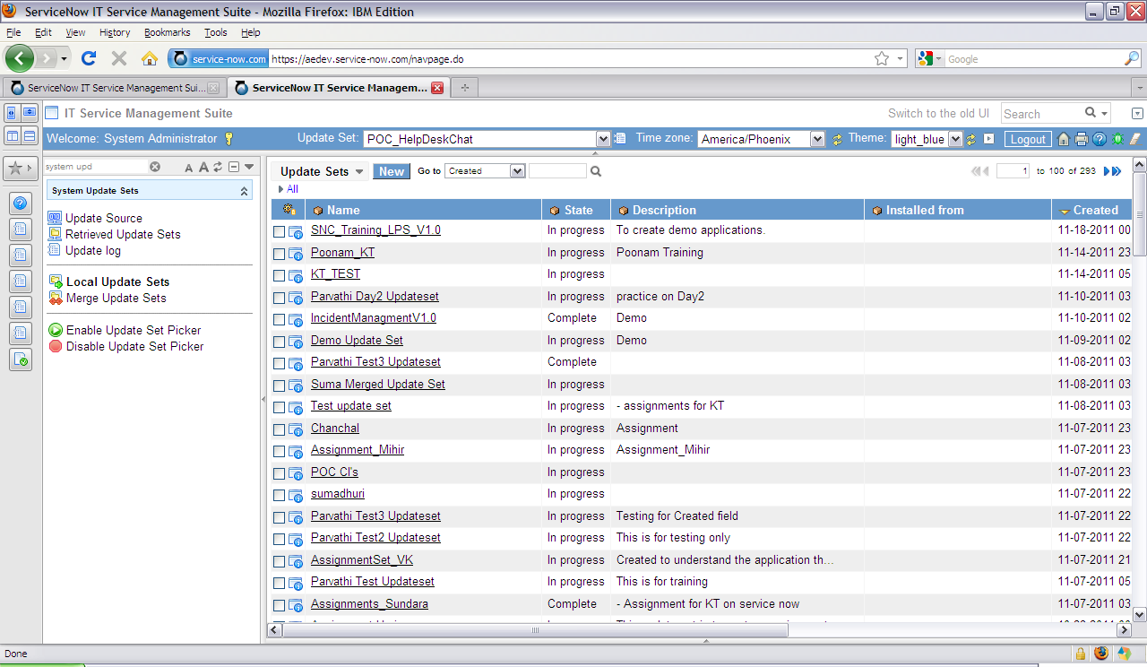
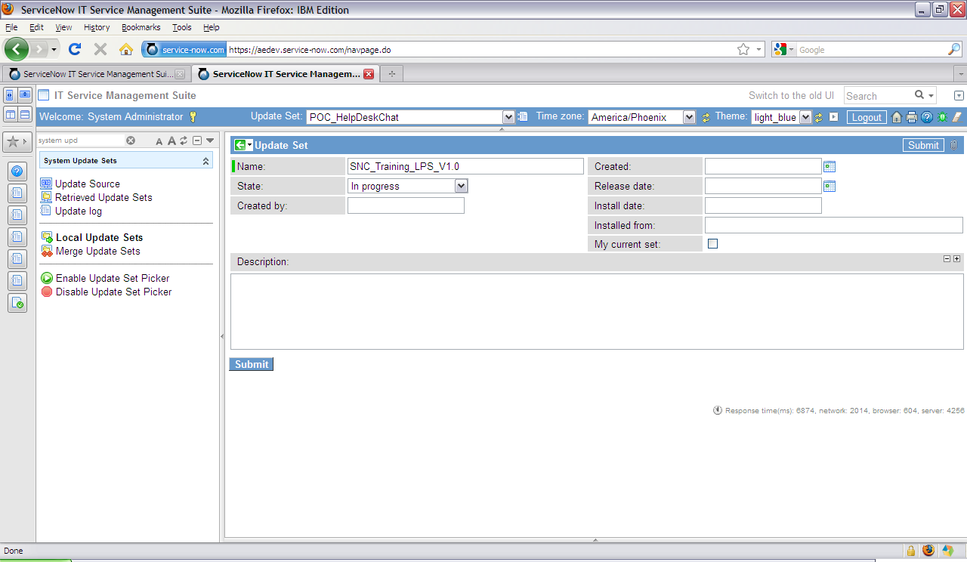
Service-Now Training
Update Set → Creating Update Set (Case Study)
Since all the customizations are captured into an update set and then moved as a unit to other systems, the first thing that we need to do for developing the Application ‘Leave Processing System’ is create an Update Set.
To create an update set for Leave Processing System, navigate to System Update Sets -> Local Update Sets and click New.
Provide Name as SNC_Training_LPS_V1.0. The future update sets for this application can be named as SNC_Training_LPS_V1.1, SNC_Training_LPS_V1.2 and so on.
Select “My current set” if this update set needs to be selected after it is created. Click on Submit.
Note
The state of the update set is “In progress” by default.
When the changes are captured in update set, the state should be changed to “Complete” in order to move it to another environment.

Slide 5
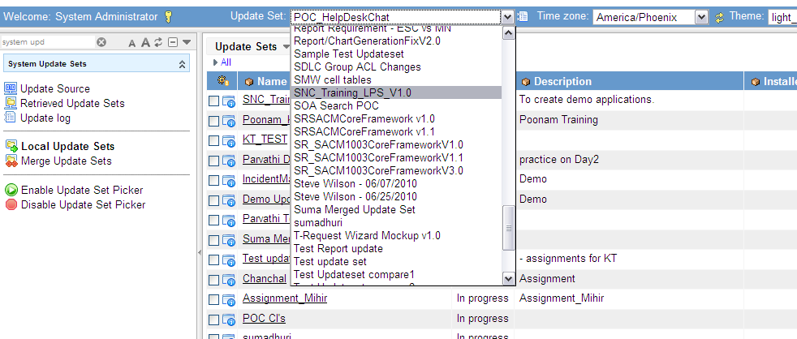
Service-Now Training
Update Set → Using Update Set
On the header bar, select the update set in which you need to capture the changes. For Leave Processing System, select SNC_Training_LPS_V1.0 from dropdown.
Note
If the changes are not to be captured in any update set for moving to another environment, select the ‘Default’ update set (Default update set is provided by the system).

Slide 6
Service-Now Training
Update Set → Best Practices
If you are working on multiple projects, always validate if you have selected the correct update set before doing any development activities.
Provide detailed description of the changes that will be captured in the update set in “Description” field. Update the description with latest changes when changing the state to “Complete” from “In progress”.

Slide 7
Service-Now Training
Update Set → Summary
You have now completed the module Update Set. The key learning points are –
An Update Set is used to capture development changes in Service-Now.
The Update Set can be moved from one application environment to other as part of deployment process.
An Update Set can be created very easily by navigating to application System Update Sets.
Developers should choose appropriate update set from Update Set picker before starting development.
Developers should be aware of the list of components that are not captured in Update Set, for example, Scheduled Jobs and should note down such changes before deployment.

Slide 8
Service-Now Training
Data
Tables and Columns
Applications and Modules
Access Control List

Slide 9
Service-Now Training
Tables and Columns
After completing this module, you will be able to understand -
Tables and Columns in Service-Now
How to create Tables
How to create Columns
Data Types in Service-Now
How to use Number Maintenance for record numbering
How to view Tables and Columns
Best Practices

Slide 10
Service-Now Training
Data → Tables and Columns → Description
A table in Service-Now can be defined in similar way as any database table, i.e., a collection of records in the database.
The table is divided into columns, which correspond to fields in the records which contain it.
Tables can be extended by other tables, creating parent tables and child tables.
In Service-Now, a table should be created before creating any other components* as all the components are created on a particular table unless they are defined global.
Service-Now defines a unique id for each record in table of data type GUID.
When a table is created, few system fields are created along with it by default. These fields include – Created, Created by, Sys_id, Updated, Update by, Updates. These fields are updated by system as and when the record is inserted/updated in a table.
Include a graphical diagram - TBD
*Service-Now components → Service-Now components can be defined as different entities that are created to achieve a particular functionality while development, for example, Client Scripts, Business Rules, UI Policies etc. Update set is not considered as a component.

Slide 11
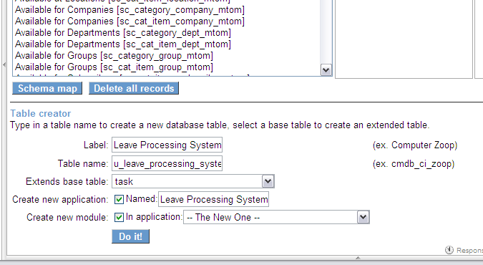
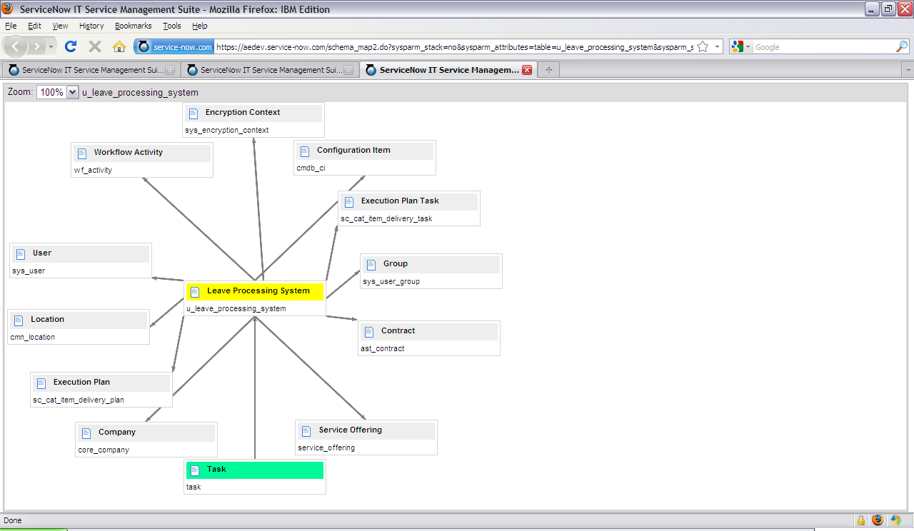
Service-Now Training
Data → Tables and Columns → Creating Tables (Case Study)
To start developing an Application, we have to create various components as per our requirement. The base where all these Components are built on, is a Table. Thus, for the 'Leave Processing System ‘,firstly, we have to create a table and then create the columns specifying it’s attributes such as Request No, Requester Name, Leave Reason, Leave Start date, end date etc.
To create ‘Leave Processing System’ table, navigate to System Definition -> Tables and Columns.
Provide Label as Leave Processing System.
The Table name will be auto filled as u_leave_processing_system.
Select task for Extends base table in order to inherit task table’s functionalities like default workflows,relationship with SLAs.
Select Create new application and Create new Module to create new application and module for Leave Processing System.
Click on Do it.
Information to be filled for table creation
You can view the relationships of table with other tables by selecting the table and clicking on ‘Schema map’. The screenshot above shows relationships for Leave Processing System Table. It can be seen that Task is parent table for Leave Processing System table.

Slide 12
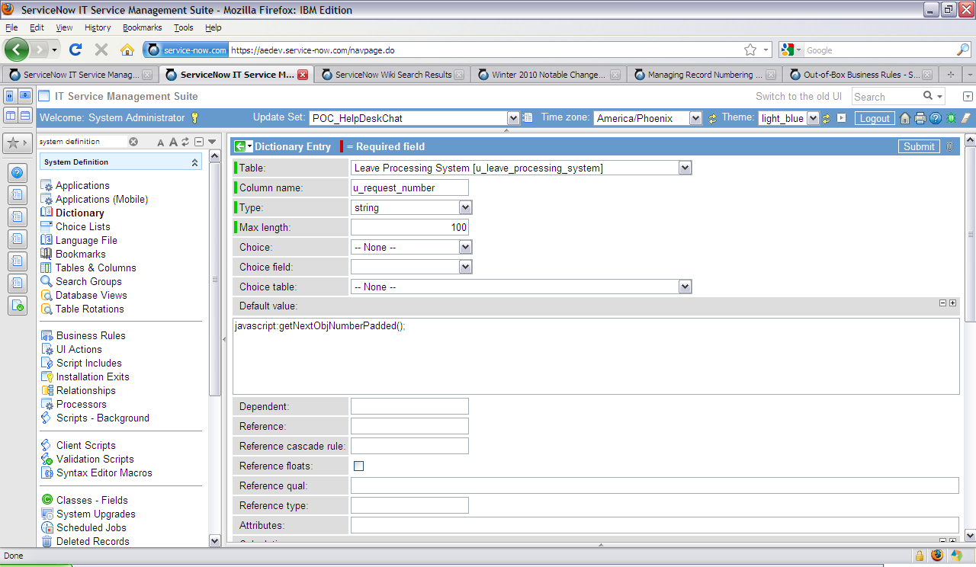
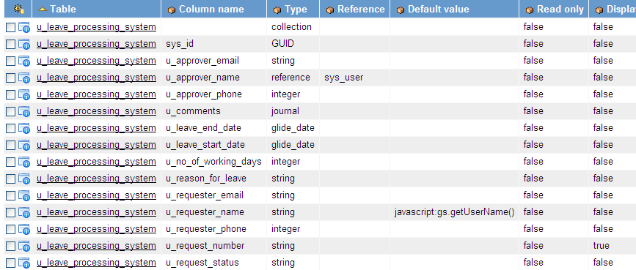
Service-Now Training
Data → Tables and Columns → Creating Columns (Case Study)
After we have created the table, we need to add Columns to that table ‘Leave Processing System’ .
To create Request Number column in Leave Processing System, navigate to System Definition -> Dictionary and click on New.
Select the Table as ‘Leave Processing System’.
Enter the Column name as u_request_number and select the Type as string.
Enter the Max length as 100.
To auto-generate Request Number, add global function getNextObjNumberPadded() in Default value field. (Details in slide ‘Number Maintenance’)
Click on Submit to create the column.
As shown in the screenshot on right, following columns are created for Leave Processing System - Requester Name, Requester Phone, Requester Email, Approver Name, Approver Phone, Approver Email, Leave Start Date, Leave End Date, No of Working Days, Reason for Leave, Comments, Request Status.

Slide 13
Service-Now Training
Data → Tables and Columns → Data types (Case Study)
Service-Now supports all most commonly used data types such as date, decimal, integer, string, boolean.etc
Service-Now has defined some proprietary data types that include
reference: This type of field refers another table. The reference table name is provided in ‘Reference’ field. For example, Approver Name is reference field and refers the table sys_user.
glide_list: This is a reference list which accepts multiple references. For example, Watch List accepts stores multiple users from sys_user table.
journal: The journal field adds timestamp and user’s name who updated the field before the updated text. The previous value appears with previous timestamps and user names who updated the field. For example, Comments is of type journal and will include the comments provides by all approvers with their name and timestamp.
glide_encrypted: To encrypt a field with a particular context, the field is defined as glide_encrypted. Only users with the context can view information on this field.
glide_date: This type of field allows to select a day which can be selected by a calendar widget. For example, Leave Start Date and Leave End Date are of type glide_date and can be selected using calendar widget.
glide_date_time: This type of field allows to select a day and time of the day which can be selected by a calendar widget.
choice: This type of field defines dropdown list of choices. The choices can be referenced from an existing table by specifying ‘Choice table’ and ‘Choice field’. The choices can also be defined in sys_choice table by adding ‘Element’ as field name and ‘Value’ as value of the choice. For example, to show ‘New’, ‘Pending’,‘Approved’, ‘Rejected’ options in dropdown for Request Status, choices are added in sys_choice table for this field.
Find more information on data types at – http://wiki.service-now.com/index.php?title=Introduction_to_Fields

Slide 14
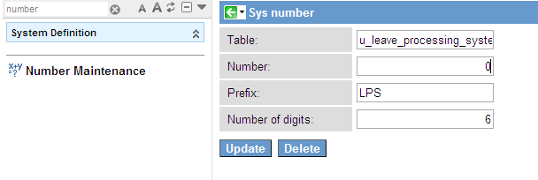
Service-Now Training
Data → Tables and Columns → Number Maintenance (Case Study)
Service-Now provides the functionality to auto generate the numbers for records.
We can ease the User of typing the Request number each time a new leave Request is created. This way we can avoid any numerical Gaps, enforce Uniqueness of Numbers and hence achieve efficient maintenance of requests in Leave Processing System.
To use auto – generation functionality navigate to System Definition -> Number Maintenance and click on New. Provide the details as below and click on Submit.
Provide Table for which the number should be auto generated. For example, to auto number Request Number for leave request, provide table name as ‘u_leave_processing_system’.
Provide the the initial Number the record should possess. For example, to generate Request Number from 1, provide the Number as 0.
A Prefix can be provided for the number. For example, for leave request records, add prefix as LPS.
Provide the Number of digits the auto generated number should have. For example, to generate number as LPS000001, provide number of digits as 6.
Navigate to the number field for your table in dictionary and call the global JavaScript function getNextObjNumberPadded() provided by Service – Now in Default value. For example, add “javascript:getNextObjNumberPadded();” as Default value for field Request Number. When a new leave request is created, the numbers will be generated as LPS000001, LPS000002 and so on.

Slide 15
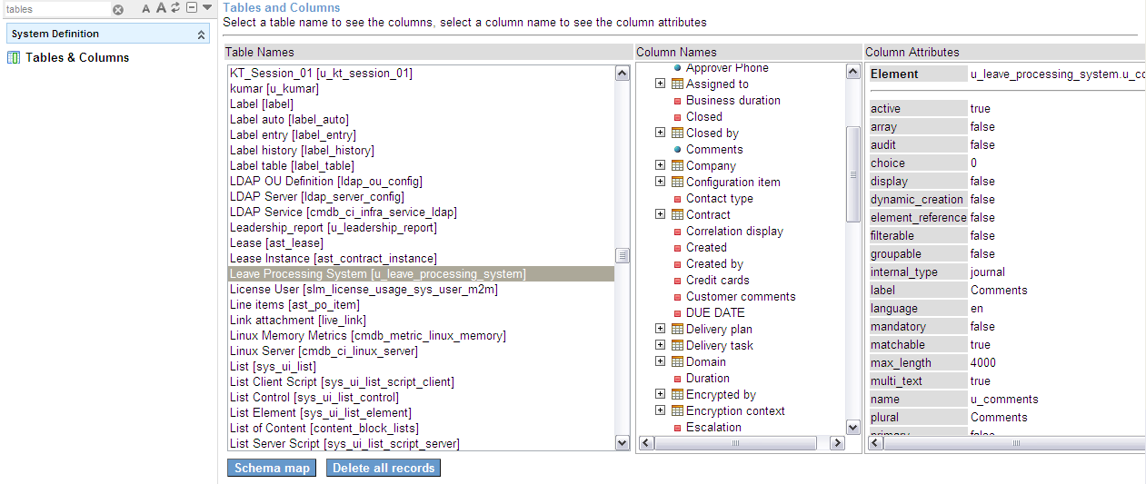
Service-Now Training
Data → Tables and Columns → Viewing Tables and Columns
To view existing tables and columns, go to System Definition -> Tables and Columns. You will see list of all tables in the system on left, columns for the selected table in the middle and column attributes on the right side of the slush bucket.
List of tables in system
List of Columns in table
Column attributes
You can view the relationships between tables graphically by clicking on “Schema map”.
Different icons are used to display the type of columns in “Column Names” –
Field residing on the selected table Field referencing another table Field is part of one or more indexes
Field residing on the parent table Field is part of on index that resides on the selected table

Slide 16
Service-Now Training
Data → Tables and Columns → Best Practices
All new tables and columns should start with ‘u_’ in order to distinguish Service - Now tables from custom tables.
The Service-Now tables or field properties (which can be extended, e.g.,task ) like label should be changed carefully as the changes will be reflected in all tables extending the table.
Task table should be extended only if there is a business need. Decision of extending task table should be made in design phase only as task table cannot be extended after a table is created.
If the table is deleted and re created, table name should not be the same as it will not be captured in update set.
If you are deleting a table, all related components (e.g., UI Policies, Client Scripts) will be deleted. To retain the components, create a new table, change table for all components and then delete the old table.
The field length should be decided in design phase as it cannot be decreased once defined.
Note
Reference type fields cannot be changed back to string.

Slide 17
Service-Now Training
Data → Tables and Columns → Summary
You have now completed the module Tables and Columns. The key learning points are –
A table in Service-Now can be defined as a collection of records in database and it can be easily created by navigating to module Tables and Columns.
Service-Now allows creation of parent-child relationship in tables.
The table is divided into columns which correspond to fields on the record’s form. Columns of different data types can be created at Dictionary module. The data types include Service-Now defined data types such as glide_date other than the standard ones such as string.
The relationships among tables can be viewed graphically using Schema Map.
The records can be numbered as per customer requirements by defining prefix, length etc using Number Maintenance table. The records can also be auto-numbered.

Slide 18
Service-Now Training
Applications and Modules
After completing this module, you will be able to understand -
What are Applications and Modules
How to create new Application
How to create new Module

Slide 19
Service-Now Training
Data → Applications and Modules → Description
An application is a set of links logically grouped together. For example, “Leave Processing System” application may include links ‘Create Leave Request’, ‘LPS Reports’ etc.
A module has the purpose of presenting the functionalities that make up an application. In above example for application, ‘Create Leave Request’, ‘LPS Reports’ are modules.

Slide 20
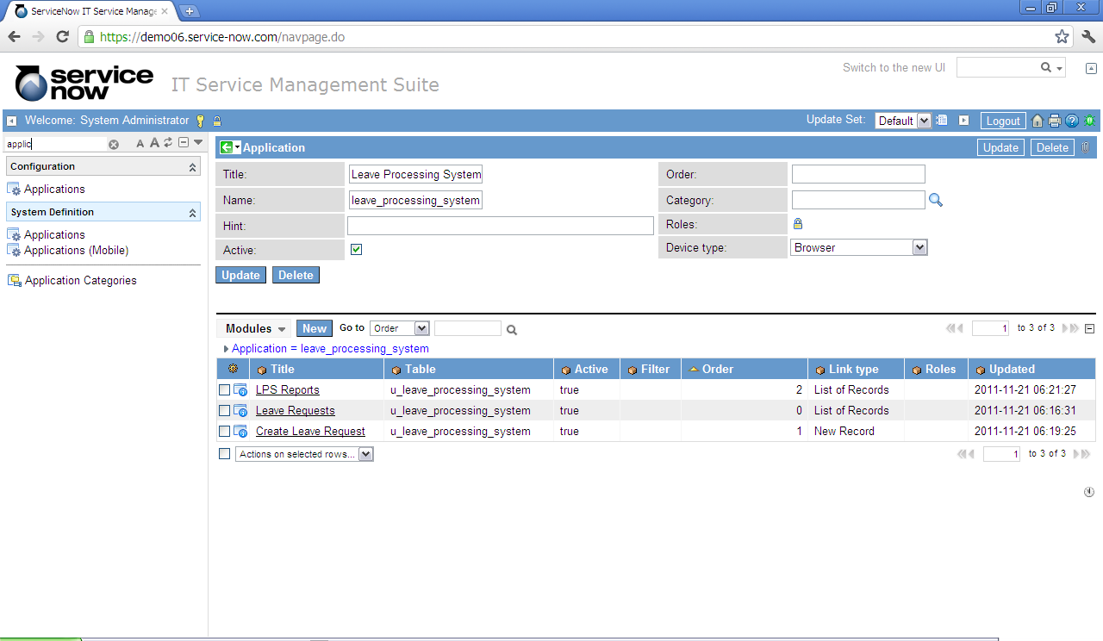
Service-Now Training
Data → Applications and Modules → Creating new Application (Case Study)
Since an Application is the logical grouping of Business Functions i.e. modules that build up a System, after defining the Table and it’s attributes for LPS, we have to associate it to a module under an Application. This Application will provide us a way to interact with the system.
When we had created the Tables and Columns for Leave Processing System, we had Selected Create new application and Create new Module and hence an Application Leave Processing System was created with a new module Create Leave Request, corresponding to the table definition created above.
An application can be created while creating a table as well as at System Definition -> Applications -> New. The Leave Processing System application and modules under it are shown below.
Modules

Slide 21
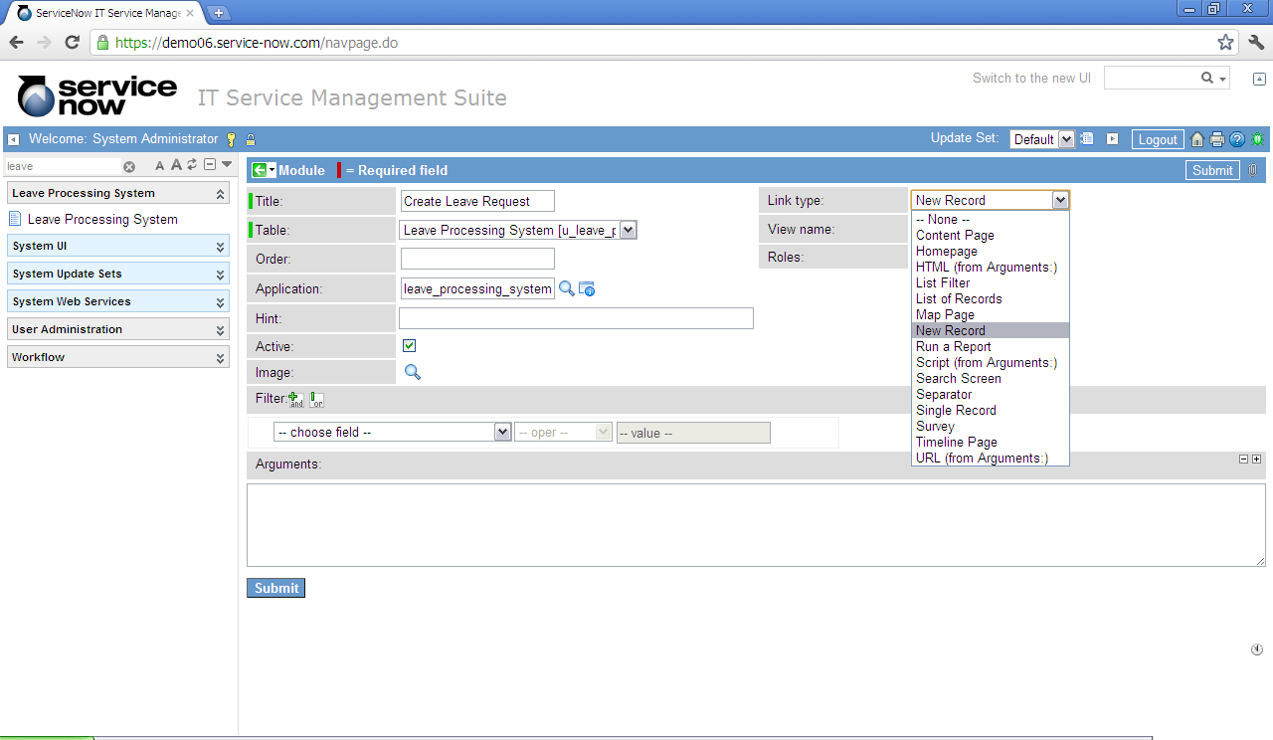
Service-Now Training
Data → Applications and Modules → Creating new Module (Case Study)
Apart from the functionality Leave Requests defined while creating the table, we may also want to add some more functions at a later stage depending on our requirement. We can do this by creating a new module under already existing application ‘Leave Processing System’.
A module can be created while creating a table as well as at System Definition -> Applications. To create a link for new leave request, open the application Leave Processing System and click on New under Modules.
Provide the details as defined below Title: Create Leave Request as Title of the application
Table: Leave Processing System as the Table on which the application has to be created on
Order: Order of the module in application
Application: leave_processing_system as the Application name
Link type: The module link type defines the result that we will get on clicking the module link. Select New Record as the link type for new leave request to be created.
Image: Icon displayed across the module
View name: Name of the view for form
Roles: Roles that are allowed to view the module
Filter: Filter condition to filter the data
Active: Select if module is in use and should be displayed
When a user clicks on this Create Leave Request module, a form to create a new leave request will appear.

Slide 22
Service-Now Training
Data → Applications and Modules → Best Practices
When module order is defined, the orders for two modules should have enough difference so that new modules can be easily inserted. For example, the order can be defined as 100, 200 etc instead on 100, 101.
As far as possible, use filter options and not the ‘URL from arguments’ type of module as it decreases the performance of application.
Module link formation by calling scripts should be avoided as it reduces the performance of the application.
Create application and module while creating the table only if required as even though the components may marked inactive, it adds load to the application.

Slide 23
Service-Now Training
Data → Applications and Modules → Summary
You have now completed the module Applications and Modules. The key learning points are –
Applications and Modules form a grouping of links that provides users a means to interact with the system.
An Application is a grouping of modules or links to different pages that provide related information and functionality.
The application can be created while creating a table or by navigating to
System Definition ->Applications.
A module is a link to the functionality in application, for example, Create Leave Request module represents functionality to create a new leave request.

Slide 24
Service-Now Training
Access Control List
After completing this module, you will be able to understand -
Security in Service-Now using Access Control List
What are different levels of Access Rules
How security can be achieved via Roles
How security can be achieved via Conditional Expressions
How security can be achieved via Script

Slide 25
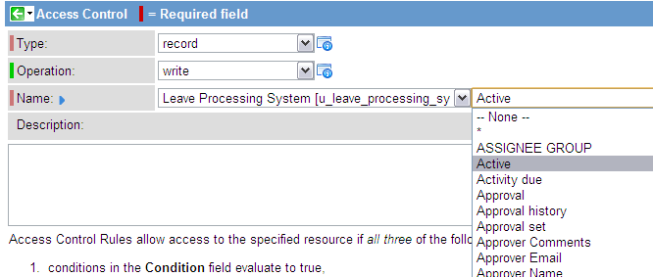
Service-Now Training
Data → Access Control List → Description
Access Control Rules provide flexibility and power to protect information by controlling read/write/create/delete authorization.
An access rule consists of
Type of entity being secured (for example, record)
Operation being secured (for example, read/write)
Name describing the element to be secured at table row level or table field level (for example, to secure Request Number column of Leave Processing System, select Name as Leave Processing System.Request Number).

Slide 26
Service-Now Training
Data → Access Control List → Access Rule Levels
Field Level Rules -
Field level rules apply security to a particular field in a particular table. For example: u_leave_processing_system.u_request_number -- this rule applies to the u_request_number field on the Leave Processing Syatem table. You can also use a wildcard if you want. For example: u_leave_processing_system.*
-- this rule applies to all fields on the Leave Processing System table except those with explicit rules. Thus, given the two rules above,
u_leave_processing_system.u_request_number
would use its explicit rule, but another field, say, u_leave_processing_system.description would use u_leave_processing_system.*
Row Level Rules –
Row level rules apply security to an entire row. For example: The rule
u_leave_processing_system –
applies to all rows in the Leave Processing System table.
Precedence between Row and Field Level Rules -
What happens if a row level rule and a field level rule are in conflict? Perhaps the row level field indicates that you shouldn't be able to write to a particular row, but the field level rule indicates you do have write access? In a nutshell, both rules must be met before an operation is allowed. So, given a row level rule on Leave Request, and a field level rule on u_leave_processing_system.u_request_number, access to the Request Number field would be allowed only if both rules evaluated to true.

Slide 27
Service-Now Training
Data → Access Control List → Access Rule Levels
Rule Search Order -
The system is aware of the object hierarchy when it tries to identify a security rule to apply to a particular entity. The search order for a field level rule is:
explicit rule on self
explicit rule on field in parent
... until parent doesn't contain field
wildcard rule on self
wildcard rule on field in parent
... until parent doesn't contain field
Example: Given u_leave_processing_system.u_request_number
Search is:
u_leave_processing_system.u_request_number
*. u_request_number
u_leave_processing_system.*
task.*
*.*
Multiple Rules at the Same Level -
What if the system, for example, finds two rules for u_leave_processing_system.u_request_number?
The system will evaluate both rules and if either is true, then the requested access is allowed.

Slide 28
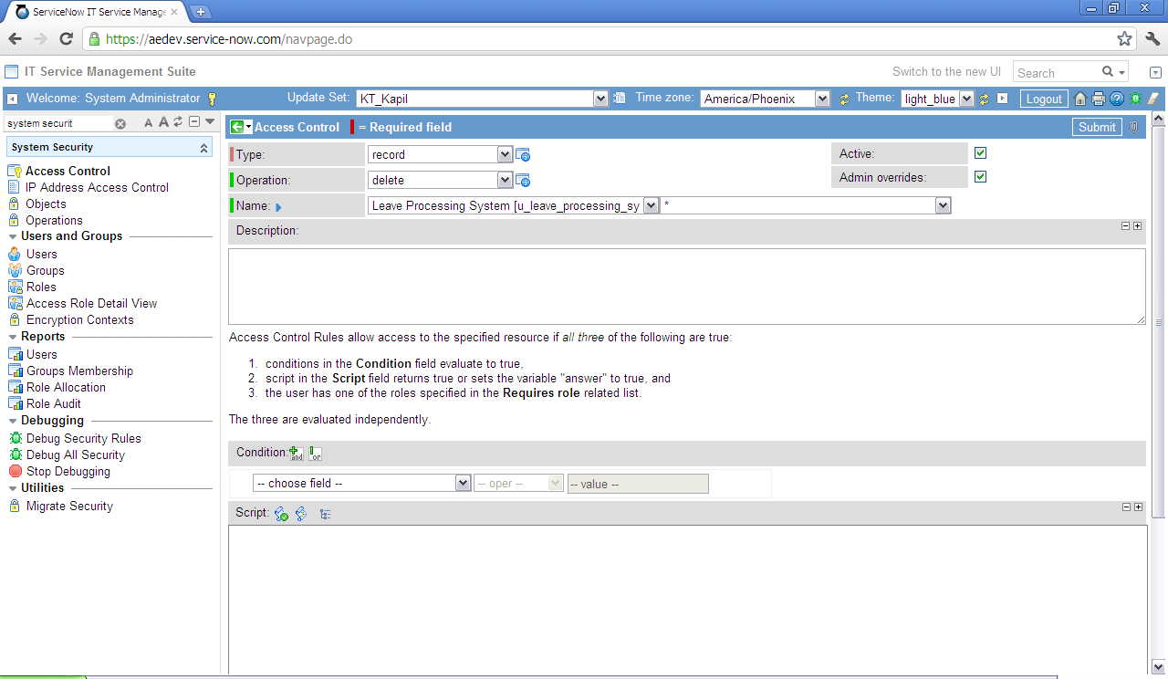
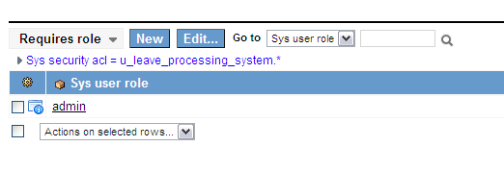
Service-Now Training
Data → Access Control List → Security via Roles (Case Study)
The access rule can be defined to restrict an operation for the users having a particular role.
To restrict deletion of leave request for users who are not system administrators, create an access rule by navigating to System Security -> Access Control and click on ‘New’.
Select the Type as record & operation as delete. Select the table Leave Processing System for Name and the level of access as ‘*’ and click on Submit.
The related list Requires Role will appear after the access rule is created. Add the role admin by clicking on Edit. So, only the users having admin role will be able delete the leave requests.

Slide 29
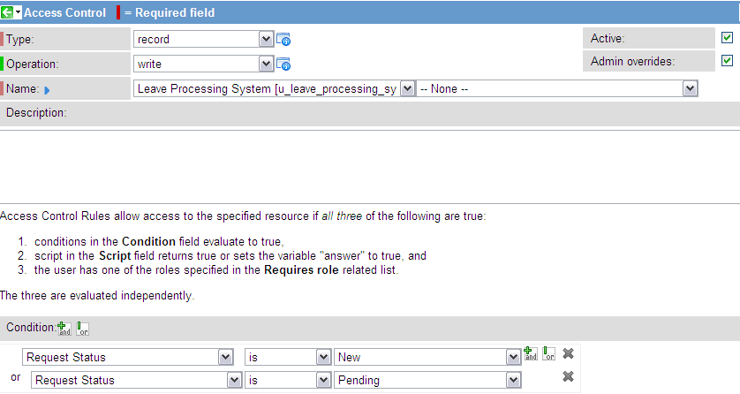
Service-Now Training
Data → Access Control List → Security via Conditional Expressions (Case Study)
An access rule can be defined for a particular operation based on specified conditions.
To allow users to edit the Leave Request only when the Request Status is New or Pending, navigate to System Security -> Access Control and click on ‘New’.
Select the Type as record & operation as write. Select the table Leave Processing System for Name and the level of access as None.
Add the Condition Request Status is New OR Request Status is Pending by selecting fields from filter
dropdown. Click on Submit.

Slide 30
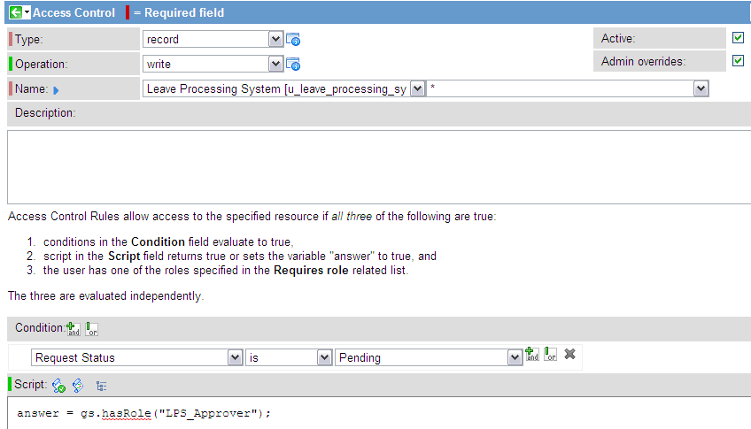
Service-Now Training
Data → Access Control List → Security via Scripts (Case Study)
The access rules can be defined via scripts.
To restrict users from editing the leave request once submitted and make it editable only for leave approver, navigate to System Security -> Access Control and click on ‘New’.
Select the Type as record & operation as write. Select the table Leave Processing System for Name and the level of access as *.
Add the script answer = gs.hasRole (“LPS_Approver”) under Script and click on Submit.
The access rule will only allow users having role LPS_Approver to edit the request when request state is Pending.

Slide 31
Service-Now Training
Data → Access Control List →Best Practices
If the access rules are defined on the parent table and child table requirement is different, instead of modifying parent table’s rule, create an access rule for child table.

Slide 32
Service-Now Training
Data → Access Control List →Summary
You have now completed the module Access Control List. The key learning points are –
Access Control List provides an ability to secure the data by defining read/write/delete/create authorization.
Access Control List can be defined in three ways –
Roles
Conditional Expressions
Scripts
ACL provides fields level security as well as row level security. Both security rules must be satisfied to perform a particular operations.

Slide 33
Service-Now Training
Import Sets
After completing this module, you will be able to understand -
What are Import Sets
What are different steps to import data
How to create a data source
How to load data
What are Transform Maps
What are Field Maps
How to transform data

Slide 34
Integration → Import Sets → Description
Service-Now provides a very powerful tool to import the data from external data sources to Service-Now tables.
Service-Now takes care of loading unique data as well skipping importing data if it is already present in Service-Now table.
The data from the external sources can be processed before it is imported in Service-Now tables.
Data import can be scheduled to run at a specified time.
Note
Data can be imported using Webservice Transform maps. Will be discussing this in detail in Web Services section

Slide 35
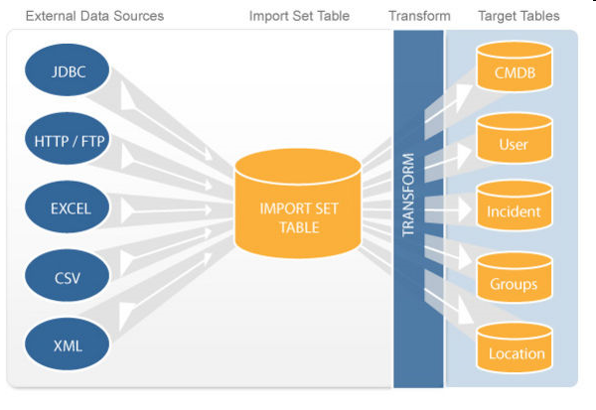
Integration → Import Sets → Steps to Import Data
Steps to import data in Service-Now include –
Create and choose the external data source, for example, JDBC, Excel, HTML etc. and load the data.
Create import set tables in Service-Now. Import set tables act as a staging area for records imported from a data source.
Define how data should be imported in ‘Transform Map’. Transform map determines the relationship between fields in import set table and fields in existing Service-Now table. The transform map can also include scripts to process the data before it is imported.
Import the data in Service-Now tables by running the Transform Map.
The steps above can be seen diagrammatically as below –

Slide 36
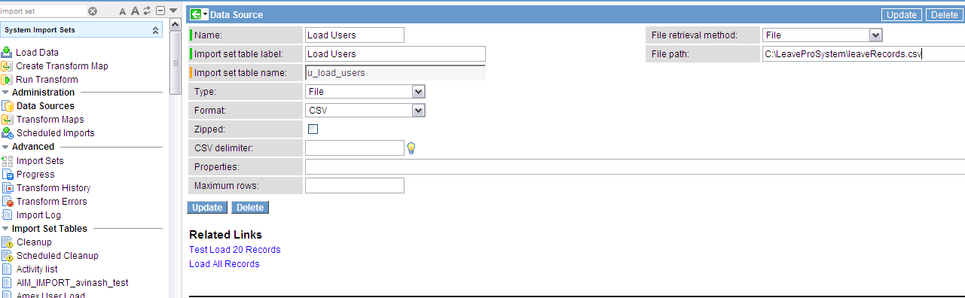
Integration → Import Sets → Create Data Source
In LPS, along with creating new users, we may want to load the users that are already existing in the System. For this, we will have to use an Import Set to import the data from ‘Users Group’ Table and load it into the target ‘Leave Processing System ‘ table.
To create the external data source ‘Load Users’ to load existing users into the ‘Leave Processing System’, go to System Import Sets -> Data Sources and click on New. Provide following information and click on Submit. A import set table and a data source will be created.
Provide unique name ‘Load Users’ of the data source
Provide the label ‘Load Users’ of the import set table.
A unique Import Set Table Name ‘u_ load_users’ is automatically created from the Label name, to avoid any collisions.
Select file Type as ‘File’ implies Data is in a file residing on a server.
Select the Format as CSV (Other options are Excel/XML etc).
Choose ‘File’ as File Retrieval Method.
Provide the Path ‘C:\LeaveProSystem\leaveRecords.csv’ to import file located at C:\LeaveProSystem on your machine. This file will have data of already existing users in System.
Note
If the File Retrieval method is FTP/FTTPS/SCP etc. Give the Name of the server from which file will be imported, Username and Password to access file from server.

Slide 37
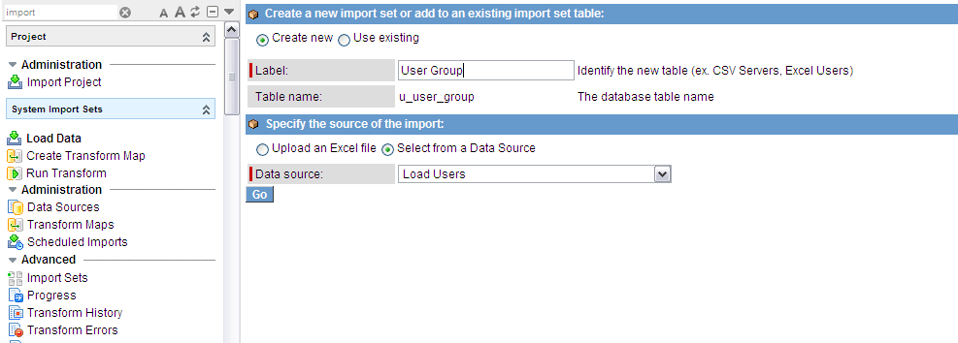
Integration → Import Sets → Load Data
After we create a Data Source, we have to load that data into a table called Import Set Table using this Data Source.
To load the data, go to System Import Sets -> Load Data.
select Create new to create new import set table ‘u_user_group’ ,where the data from mentioned file will be loaded.
Give a unique Label name ‘User Group’. Table Name will be system generated based on the Label entered.
Choose the data source ‘Load Users’ by selecting Select a Data Source. If the data source is an excel file, choose Upload an Excel file.
Click on Go. The data will be loaded in Service-Now. An import set table ‘u_user_group’ will be created.

Slide 38
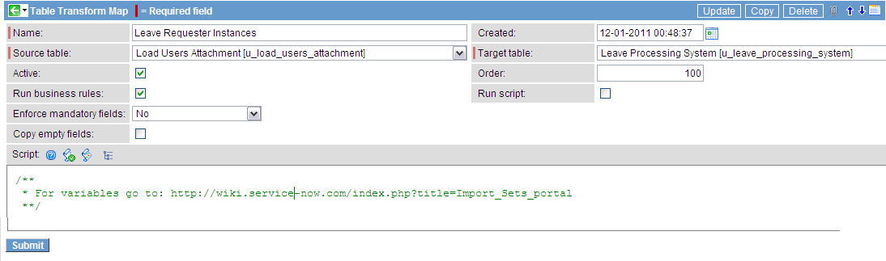
Service-Now Training
Integration → Import Sets → Transform Maps
The next step is to create a Transform Map to map the data from the import set created above to the LPS table. It will be used to determine the relationships between fields in the Import Set and fields in the LPS table eg. ‘Created By’ field.
To create a Transform Map ‘Leave Requester Details’, go to System Import Sets -> Administration -> Transform Maps and click on New. Provide following information and click on Submit.
‘Leave Requester Instances’ as Name of the transform map
The import set table ‘u_user_group’ where the data is loaded
Select Active to make the transform map available for use
Select Run Business Rules to determine that business rules on the target table will be run after inserts or updates caused by the transform map
Deselect Copy empty fields which specifies that In the event of an update where the source record has a blank field that corresponds to a populated field on the target record, the populated field will not be overwritten with the empty field.
Enter the Target Table as ‘Leave Processing System’ as the table where data is imported
Give the order as 100.
Select Run Script to execute the Transform Script.
Deselect Enforce mandatory fields which implies that the mandatory fields on the target table should not be enforced

Slide 39
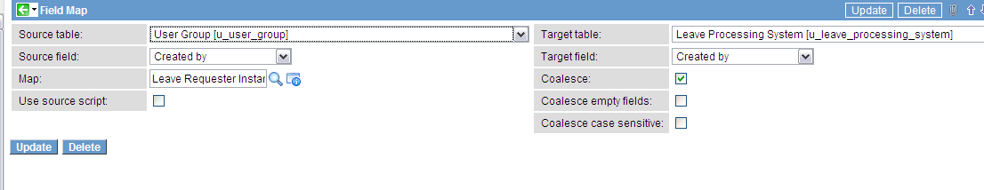
Service-Now Training
Integration → Import Sets → Field Maps
When the Transform Map is created, field map appears in the related list. It determines relationship between fields of import set table and fields of target table. The field map consists of following fields:
Source table ‘User Group’, the import set table where the data is loaded
The Source field ‘Created By’ on the source table to be transformed
The transform Map ‘Leave Requester Instances’ that calls upon the field map
Choice action, is available when target field is reference field or choicelist. Choose to create a new choice/ignore/reject the record.
Deselect Use source script to not to override the source field with a script
Target table ‘Leave Processing System’, the table where data is imported
Target field ‘Created By’ ,the field of the target table where data will be stored from source field
You can Select Coalesce if existing records in target table should be updated rather than simply inserting
Select Coalesce empty fields if a new record has to be created if the coalesced source field has a null value in the record being imported. Here the check box is not selected means the row is ignored and no new record is created.
Note
The field map can be created manually or by using controls ‘Auto map matching fields’ and ‘Mapping assist’.

Slide 40
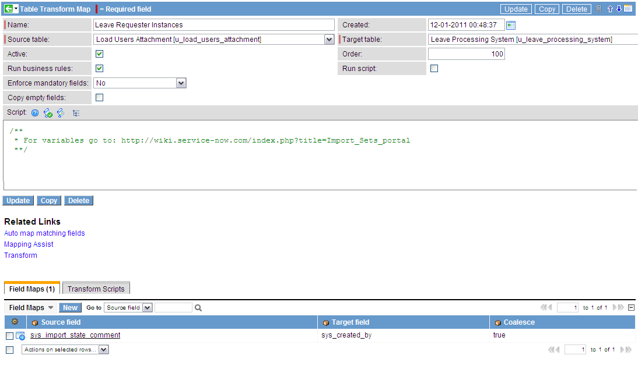
Service-Now Training
Integration → Import Sets → Transform Data
To transform, click on ‘Transform’ in related links of the Transform Map. The data will be loaded in the target Service-Now table ‘Leave Processing System (u_leave_processing_system)’.

Slide 41
Service-Now Training
Importsets -> Best Practices:
Data should be loaded before mapping the fields.
Always make sure that fields are mapped correctly and the conditions are specified.
Coalesce should be defined to the correct field.

Slide 42
Service-Now Training
Integration → Import Sets → Summary
You have now completed the module Import Sets. The key learning points are –
Import Sets is a powerful tool used to import data from various data sources, and then map that data into ServiceNow tables.
The Import Sets table acts as a staging area for records imported from a data source.
A Transform Map determines the relationships between fields displaying in an Import Set table to fields in an existing ServiceNow table.

